Slide 1
CAPGEMINI AGENTAI BUILDATHON · ROUND 2
Automated Knowledge Base Agent
AI-powered knowledge discovery from scattered documents — transforming organizational knowledge into trusted, searchable, and structured answers.
Team: SuperVerse · Niswanth T · NareshKumar J · NithishSarwin M · VictorVengatesh M · Bharath B
Roles: Agent Architect · Backend & RAG Developer · UI/UX Developer · Evaluation & Compliance Lead
Niswanth T– B.E Artificial Intelligence and Machine Learning, 4th Year
NareshKumar J – B.E Artificial Intelligence and Machine Learning, 4th Year
NithishSarwin M– B.E Artificial Intelligence and Machine Learning, 4th Year
Victor Vengatesh M – B.E Artificial Intelligence and Machine Learning, 4th Year
Bharath B– B.E Artificial Intelligence and Machine Learning, 4th Year

Slide 2

The Problem: Knowledge Is Trapped in Documents
Every organization accumulates vast libraries of internal documents — HR policies, IT manuals, finance reports, legal files, project documentation, employee handbooks, and training materials. Yet when employees need specific answers, that knowledge remains buried, fragmented, and difficult to access reliably.
Time Lost to Manual Search
Answers Hidden in Long Files
Employees waste significant time manually opening, scrolling through, and searching across PDFs, DOCX files, and TXT documents — often without finding the right answer. Repetitive queries drain productivity across the entire organization.
Critical information is frequently buried deep inside lengthy documents. A single policy may span 80 pages, with the relevant clause on page 47 — invisible to anyone who doesn't already know where to look.
Duplicate and Outdated Documents
No Visibility for Administrators
Without centralized version control, multiple versions of the same policy circulate simultaneously. Employees cannot easily determine which document is the current source of truth, leading to inconsistent decisions and compliance risk.
Admins have no clear view of what users are searching for, which documents are most accessed, or where knowledge gaps exist. This makes it impossible to proactively improve the quality and completeness of the knowledge base.
Key message: Finding the right information from company documents is slow, repetitive, and unreliable — costing organizations time, accuracy, and confidence.

Slide 3

DocAI: The Solution
DocAI is an AI-powered enterprise platform that converts scattered company documents into a trusted, searchable knowledge system. Rather than manually hunting through files, employees ask natural language questions and receive clear, citation-backed answers drawn directly from the organization's document library.
What DocAI Enables
How It Changes the Workflow
Upload new documents or query from already indexed files
Ask questions in plain, natural language
Receive clear, structured answers with source citations
Download the original source document for full reference
Maintain a personal search history for continuity
Help admins monitor usage patterns and document quality
Instead of opening a 60-page HR policy and searching for a specific clause, an employee simply asks: "What is the leave approval process?" DocAI locates the relevant section, extracts the answer, cites the source document and page, and presents a clear response in seconds.
DocAI works across all document types — PDF, DOCX, and TXT — and supports both newly uploaded files and previously stored documents already in the knowledge base. It is designed not just for basic chat, but for practical, enterprise-grade document retrieval where accuracy and traceability matter.
Key message: DocAI converts scattered company documents into a trusted, searchable knowledge system — eliminating manual search and delivering citation-backed answers at scale.

Slide 4
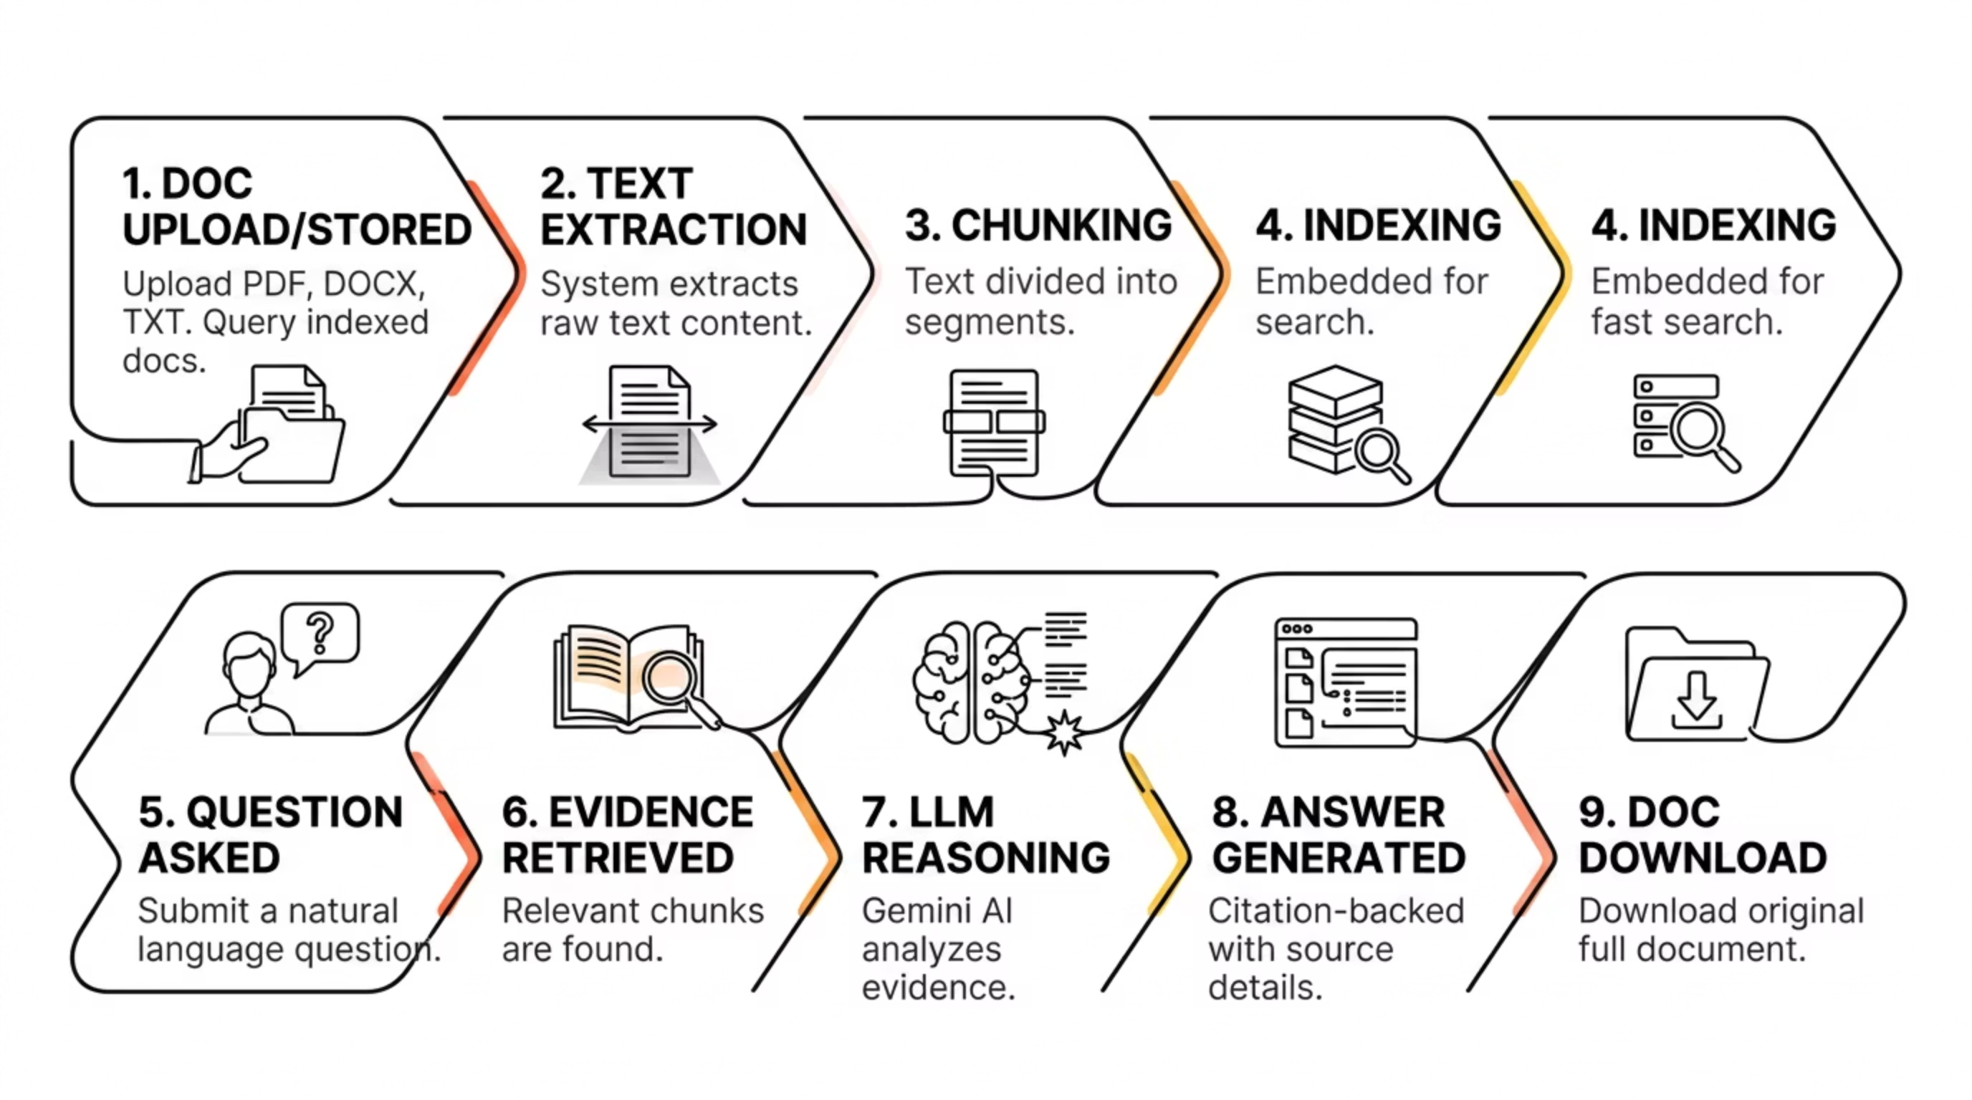
How DocAI Works
DocAI's pipeline transforms raw documents into intelligent, queryable knowledge through a structured, multi-stage process. From upload to answer, every step is designed to ensure accuracy, traceability, and relevance.
This end-to-end pipeline ensures that every answer is grounded in actual document evidence. DocAI can respond from newly uploaded documents in real time, or from previously stored and indexed documents already in the knowledge base — making it equally effective for onboarding new content and querying established libraries.

Slide 5
Core Features
DocAI is built for practical enterprise document retrieval — not just basic chat. Its feature set addresses the full lifecycle of document-based knowledge management, from ingestion and search to quality monitoring and administration.
Multi-Format Support
Flexible Query Scope
Full support for PDF, DOCX, and TXT documents — the most common formats in enterprise environments. Documents are processed automatically upon upload.
Ask questions across all documents in the knowledge base, or narrow the scope to a specific selected document for targeted retrieval.
Multiple Answer Modes
Citation-Backed Answers
Choose from simple, detailed, executive, and step-by-step answer modes — tailoring the depth and format of responses to the user's needs.
Every answer includes source document name, page reference, and citation relevance — making results trustworthy and fully verifiable.
Original Document Download
Auto FAQ & Taxonomy
Users can download the original source document directly from the answer interface for full reference and audit purposes.
DocAI automatically generates FAQs and taxonomy tags from document content, improving discoverability and knowledge organization without manual effort.
Search History
Review Queue
Users maintain a personal search history, enabling continuity across sessions and helping them track previously explored topics.
Low-confidence answers are flagged in a review queue, allowing admins to audit, validate, and improve knowledge quality over time.

Slide 6



Ask Agent & Citation-Backed Answers
At the heart of DocAI is the Ask Agent — an intelligent interface that allows users to query the knowledge base in natural language and receive structured, evidence-backed responses. Every answer is traceable to its source, ensuring trust and accountability in enterprise decision-making.
Example User Queries
What DocAI Returns
"What is the leave approval process?"
"What role is mentioned in this internship document?"
Clear Answer
A structured, readable response directly addressing the question asked.
Answer Confidence
"What is the main purpose of this project paper?"
A confidence indicator showing how strongly the evidence supports the answer.
Relevant Evidence
The specific text excerpt from the source document that supports the answer.
Source & Page Reference
Document name and exact page number for full traceability.
Download Option
One-click access to download the original source document.
Key message: Every answer is supported by document evidence — making results trustworthy, verifiable, and suitable for enterprise use cases where accuracy is non-negotiable.

Slide 7

User & Admin System
DocAI supports a dual-role architecture designed for both everyday employees and system administrators. Each role has a tailored experience that balances ease of use with operational oversight — ensuring the platform serves the full organization effectively.
User Features
Admin Features
Employees interact with DocAI through a streamlined, intuitive interface focused on knowledge retrieval:
Administrators have access to a comprehensive management layer that provides full visibility and control over the knowledge system:
Signup & Login — Secure authentication with profile management and password controls
Ask Questions — Natural language queries across the full document library or specific files
Search History — Personal history of past queries for continuity and reference
Download Sources — Direct access to original documents cited in answers
Separate Admin Login — Dedicated authentication and access control for administrators
User Management — Manage user accounts, permissions, and access levels
Search Analytics — Monitor what users are searching for and identify knowledge demand patterns
Download Analytics — Track which documents are most accessed and referenced
Review Queue — Audit low-confidence answers and flag content for improvement
System Logs — Full audit trail of platform activity and system events
Knowledge Quality Monitoring — Ongoing oversight of document health, conflicts, and gaps
Key Message : DocAI supports both employees and administrators in a company environment — combining intuitive end-user experience with robust enterprise-grade management tools.

Slide 8
Knowledge Quality Management
DocAI is far more than a vector database. While traditional retrieval systems simply return similar text chunks, DocAI actively manages the complete knowledge lifecycle — ensuring the knowledge base remains clean, trusted, and genuinely useful over time.
Source-of-Truth Ranking
Duplicate Detection
DocAI ranks documents by authority and recency, ensuring that the most reliable and up-to-date sources are prioritized in answers. This eliminates ambiguity when multiple documents cover the same topic.
The platform automatically identifies duplicate or near-duplicate documents, alerting admins to consolidate redundant content and reduce noise in the knowledge base.
Conflict Detection
Knowledge Gap Detection
When two documents contain contradictory information on the same topic, DocAI flags the conflict — enabling admins to resolve inconsistencies before they cause operational confusion.
By analyzing search queries that return low-confidence or no results, DocAI identifies areas where the knowledge base is incomplete — guiding admins to create or upload missing content.
Low-Confidence Review Queue
Document Health Monitoring
Answers generated with low confidence are automatically queued for admin review, creating a continuous feedback loop that improves answer quality over time.
Admins receive ongoing visibility into the overall health of the knowledge base — including document freshness, coverage, and usage patterns — enabling proactive knowledge management.
Key message: A vector database retrieves similar chunks — but DocAI manages the complete knowledge lifecycle, helping companies keep their knowledge base clean, trusted, and useful.

Slide 9
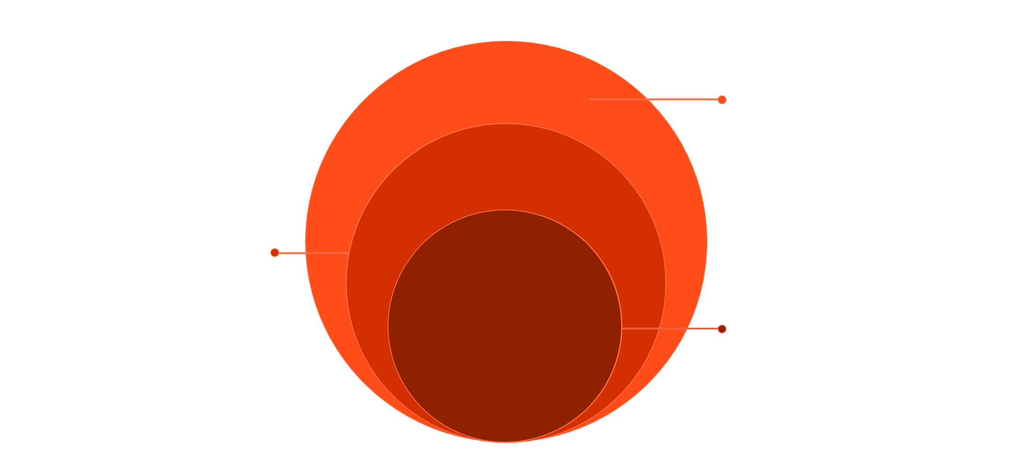
System Architecture & Tech Stack
DocAI is built on a modern, scalable technology stack designed for enterprise reliability and performance. The architecture cleanly separates the frontend, backend, and AI processing layers — enabling independent scaling, maintainability, and rapid iteration.
API & Frontend
FastAPI (Uvicorn) and React TS on Vercel
Processing Engine
Extract, chunk, index, and semantic search
LLM Reasoning
Gemini generates citation-backed answers
The architecture ensures a seamless flow from user interaction through document processing, retrieval, and AI reasoning — delivering citation-backed answers with full traceability at every step.
Backend & AI Stack
Frontend Stack
Python — Core backend language for document processing and AI integration
FastAPI + Uvicorn — High-performance async API framework for low-latency responses
Gemini API — Google's large language model for reasoning and answer generation
Local Document Storage — Secure on-premise or cloud storage for uploaded files
Local Metadata Storage — Structured storage for document metadata, citations, and user data
Retrieval Pipeline — Custom semantic search engine for accurate, context-aware document retrieval
React — Component-based UI framework for a responsive, modern interface
TypeScript — Strongly typed JavaScript for reliability and maintainability
Vite — Fast build tool and development server for rapid iteration
Vercel — Cloud platform for seamless frontend deployment and scaling
Key message: DocAI combines document processing, retrieval, reasoning, and enterprise management into one cohesive, scalable platform — built for the demands of modern organizations.

Slide 10
DocAI: Built for Enterprise Knowledge
DocAI represents a new category of enterprise tool — one that bridges the gap between raw document storage and intelligent, actionable knowledge. It is designed for organizations that take information accuracy, traceability, and governance seriously.
Trusted Answers
Enterprise Ready
Every response is citation-backed and traceable to its source document — no hallucinations, no guesswork.
Role-based access, admin oversight, analytics, and knowledge quality management built in from the ground up.
Scalable Architecture
Continuous Improvement
Modern tech stack — React, FastAPI, Gemini — designed to scale with your organization's document library and user base.
Review queues, conflict detection, and knowledge gap analysis ensure the platform gets smarter over time.
DocAI converts scattered company documents into a trusted, searchable knowledge system — eliminating manual search and delivering citation-backed answers at enterprise scale.

